Slide 1
2016 Global Studies Alumni Survey Facts
23% reported completing a second major.
55% of respondents reported going to graduate school.
49% reported living in Illinois, 14% reside in the Washington D.C. area and 5.5% live outside the United States.
Most popular MBA programs are University of Illinois at Chicago and Northwestern graduate programs.
Most popular Law programs chosen were University of Illinois at Urbana-Champaign and John Marshall.
Alum who reported going to medical school chose Tulane University, University of Wisconsin and University of Illinois.
12% of Global Studies Alum who elected to attend graduate school attended a university overseas.

Slide 2
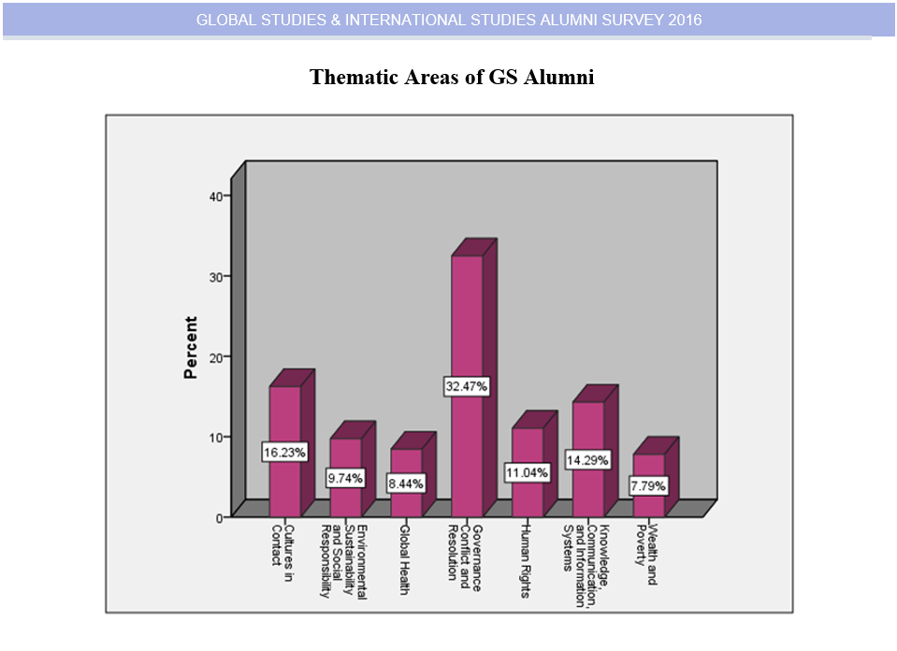

Slide 3
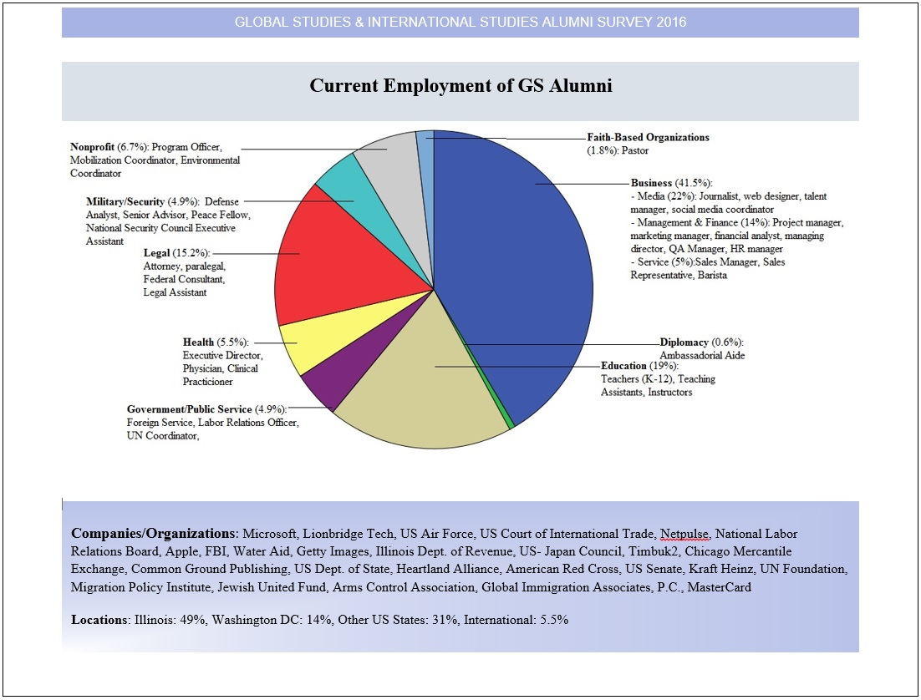

Slide 4
